Slide 1
COMP H2015 LAN Switching and Wireless Revision
Year 2, Semester 1
Aoife Fox

Slide 2
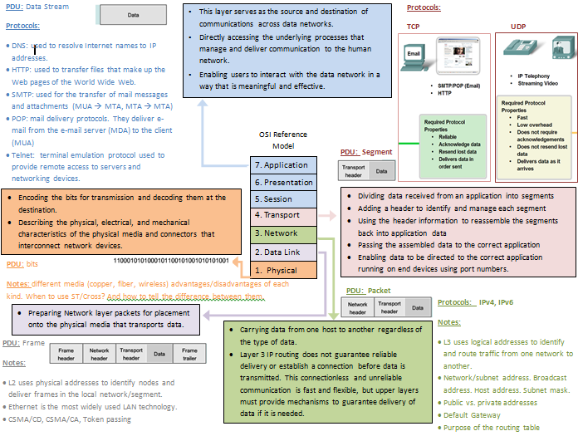

Slide 3
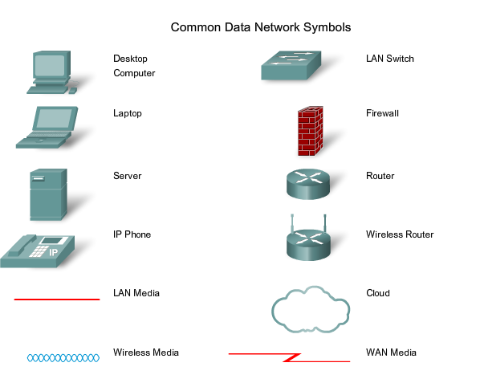
Cisco Symbols

Slide 4
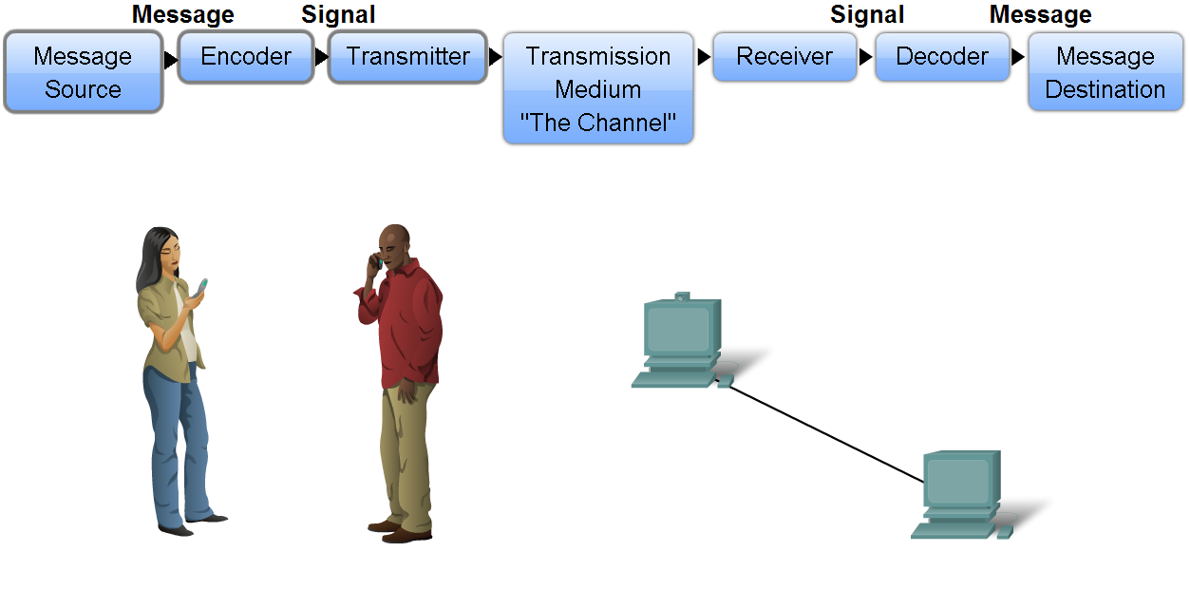
Network Structure
Define the elements of communication
  3 common elements of communication
    message source
    the channel
    message destination
Define a network
  data or information networks capable of carrying many different types of communications

Slide 5
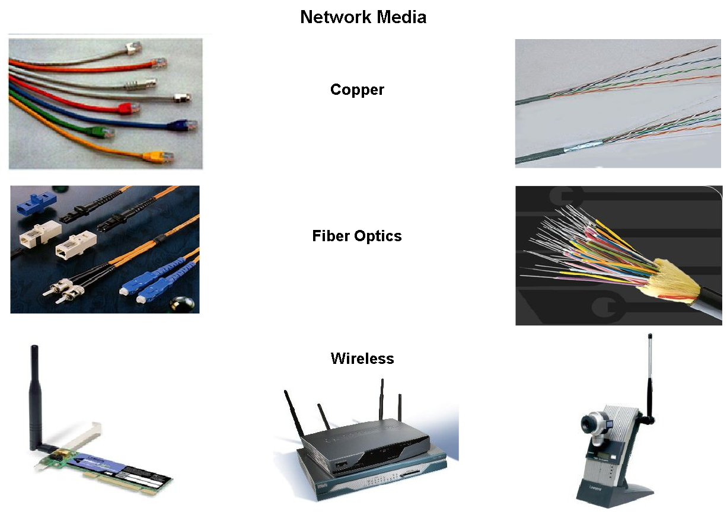
Network Structure
  Network media - this is the channel over which a message travels

Slide 6
Networking Media
Modern networks primarily use three types of media to interconnect devices and to provide the pathway over which data can be transmitted. These media are:
Metallic wires within cables
Glass or plastic fibers (fiber optic cable)
Wireless transmission
The signal encoding that must occur for the message to be transmitted is different for each media type. On metallic wires, the data is encoded into electrical impulses that match specific patterns.
Fiber optic transmissions rely on pulses of light, within either infrared or visible light ranges. In wireless transmission, patterns of electromagnetic waves depict the various bit values.

Slide 7
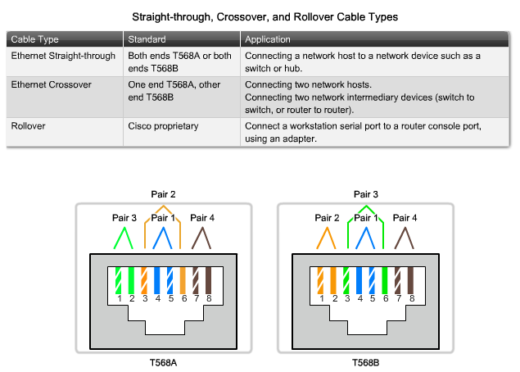
UTP Cable Types

Slide 8
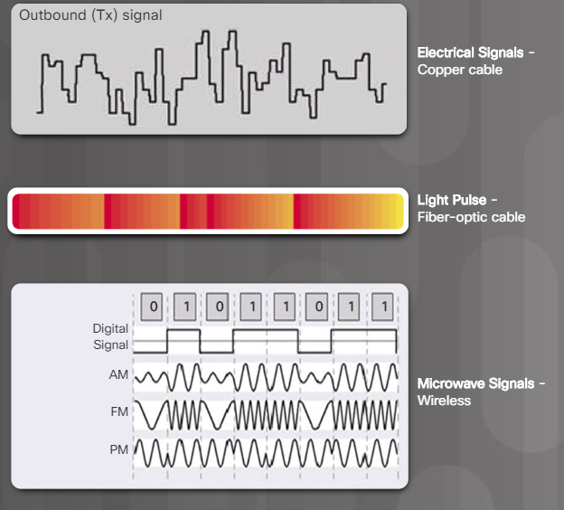

Characteristics & Uses of Network Media
Identify several media characteristics defined by Physical layer standards.

Slide 9
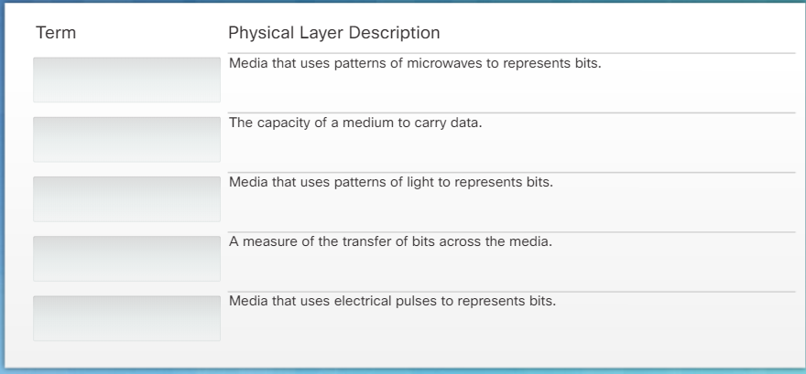
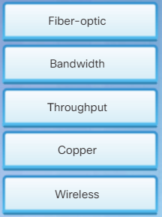
Activity

Slide 10
Connections
As a reminder, the common uses are listed again:
Use straight-through cables for connecting:
Switch to router
Computer to switch
Computer to hub
Use crossover cables for connecting:
Switch to switch , Switch to hub
Hub to hub. Router to router
Computer to computer , Computer to router

Slide 11
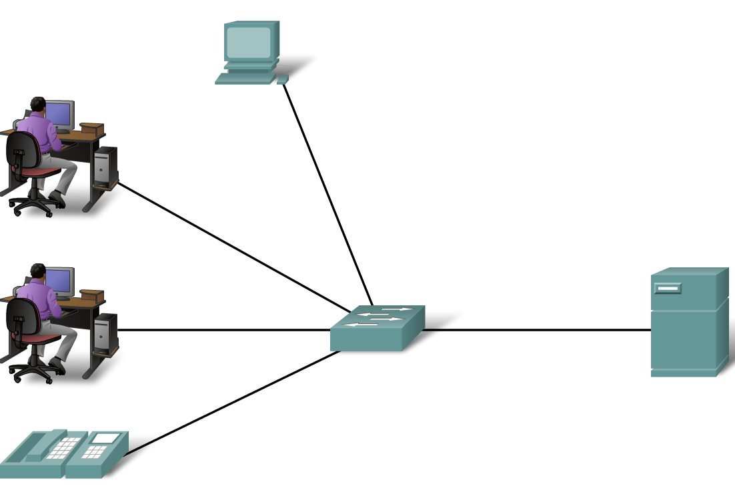
What type of Network?

Slide 12
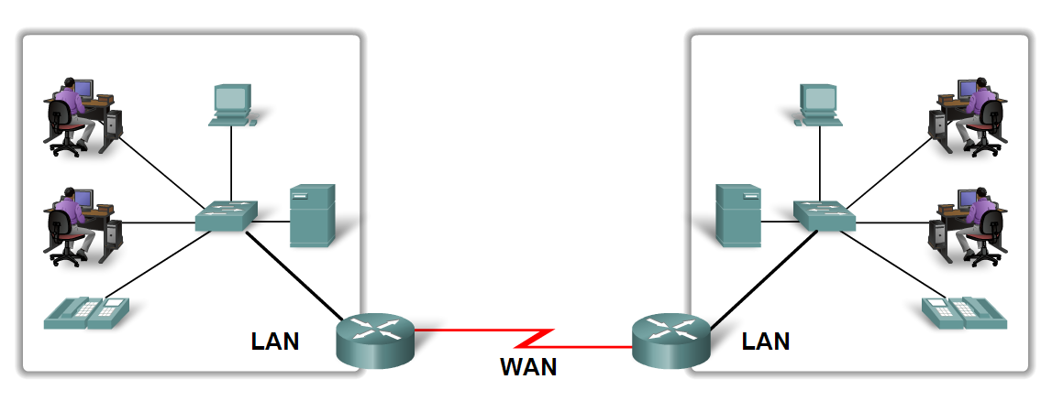
What type of Network?

Slide 13
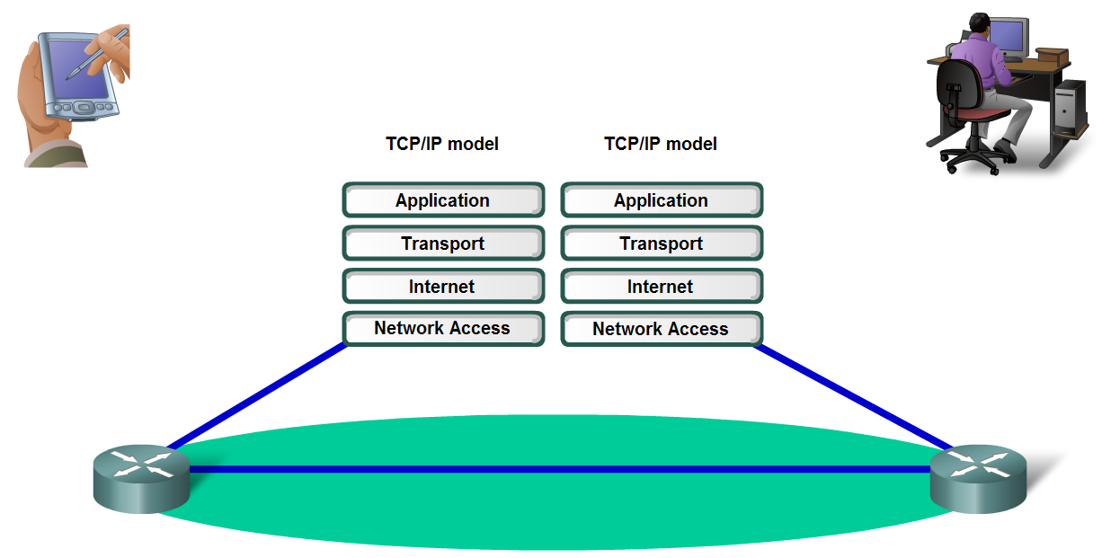
Layers with TCP/IP and OSI Model
Describe the Communication Process

Slide 14
Communication Steps
Creation of data at the Application layer of the originating source end device
Segmentation and encapsulation of data as it passes down the protocol stack in the source end device
Generation of the data onto the media at the Network Access layer of the stack
Transportation of the data through the internetwork, which consists of media and any intermediary devices
Reception of the data at the Network Access layer of the destination end device
Decapsulation and reassembly of the data as it passes up the stack in the destination device
Passing this data to the destination application at the Application layer of the destination end device

Slide 15
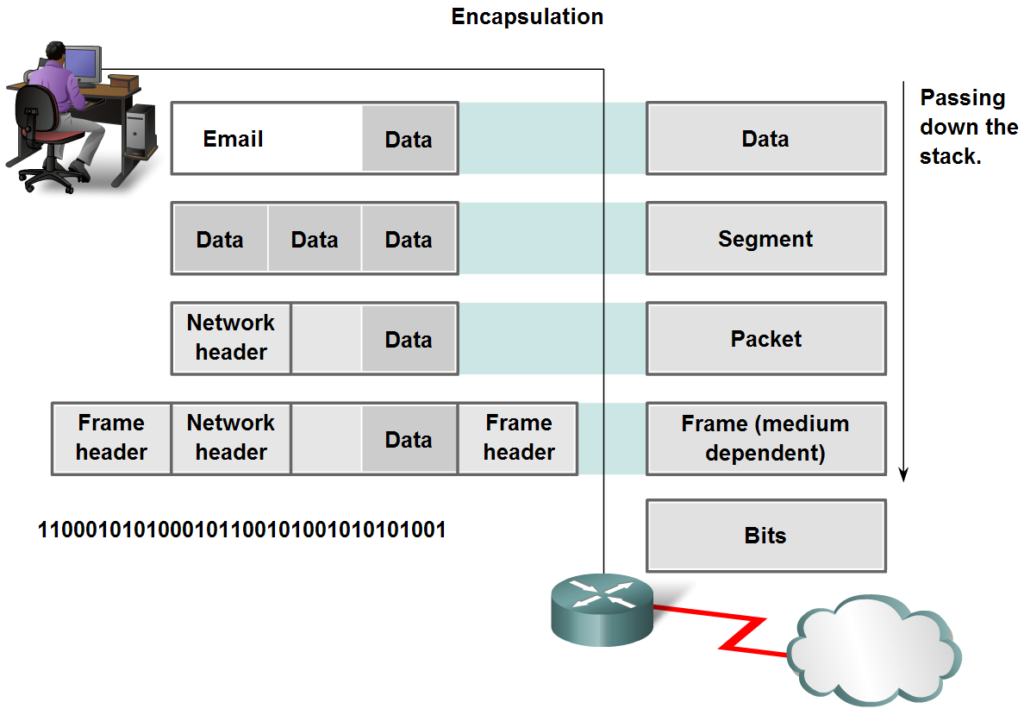
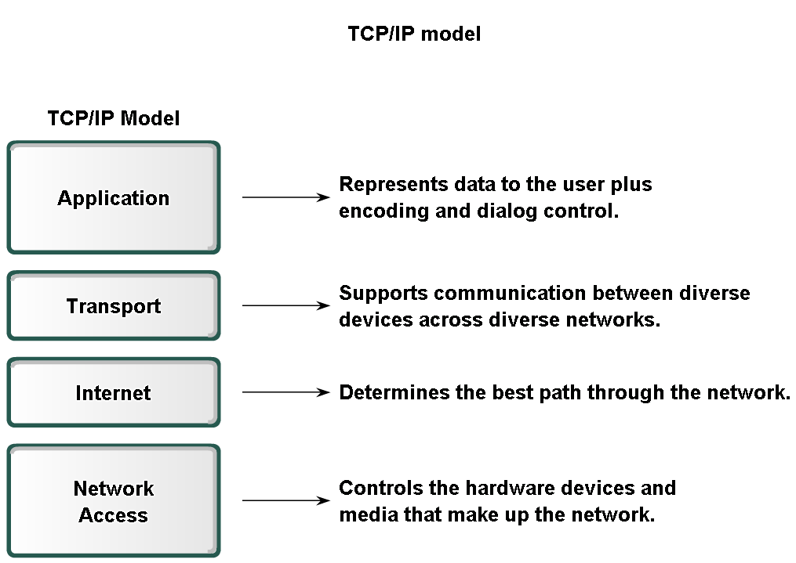
Layers with TCP/IP and OSI Model
Explain protocol data units (PDU) and encapsulation

Slide 16
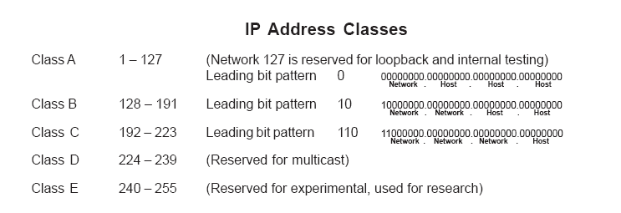
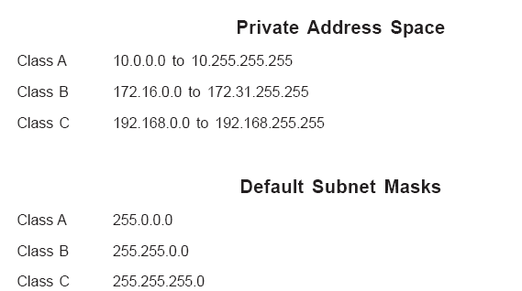

Slide 17
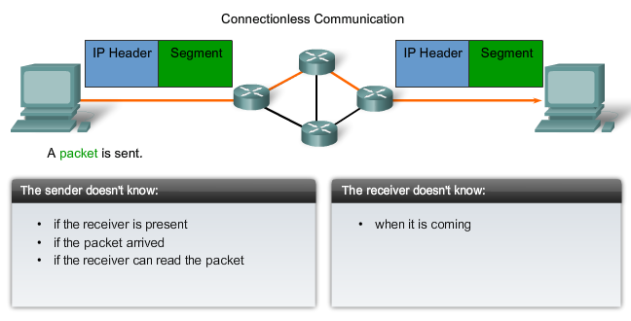
Data Network

Slide 18
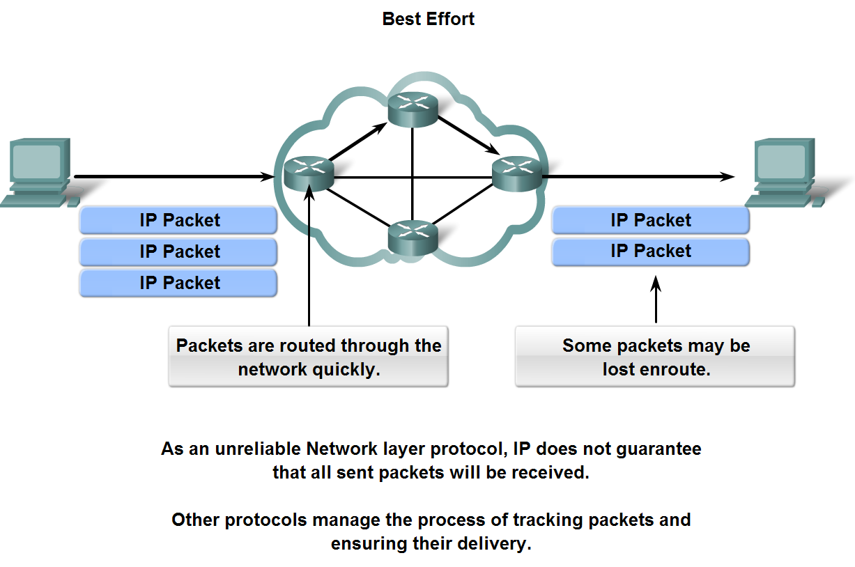
Network Layer Protocols and Internet Protocol (IP)

Slide 19
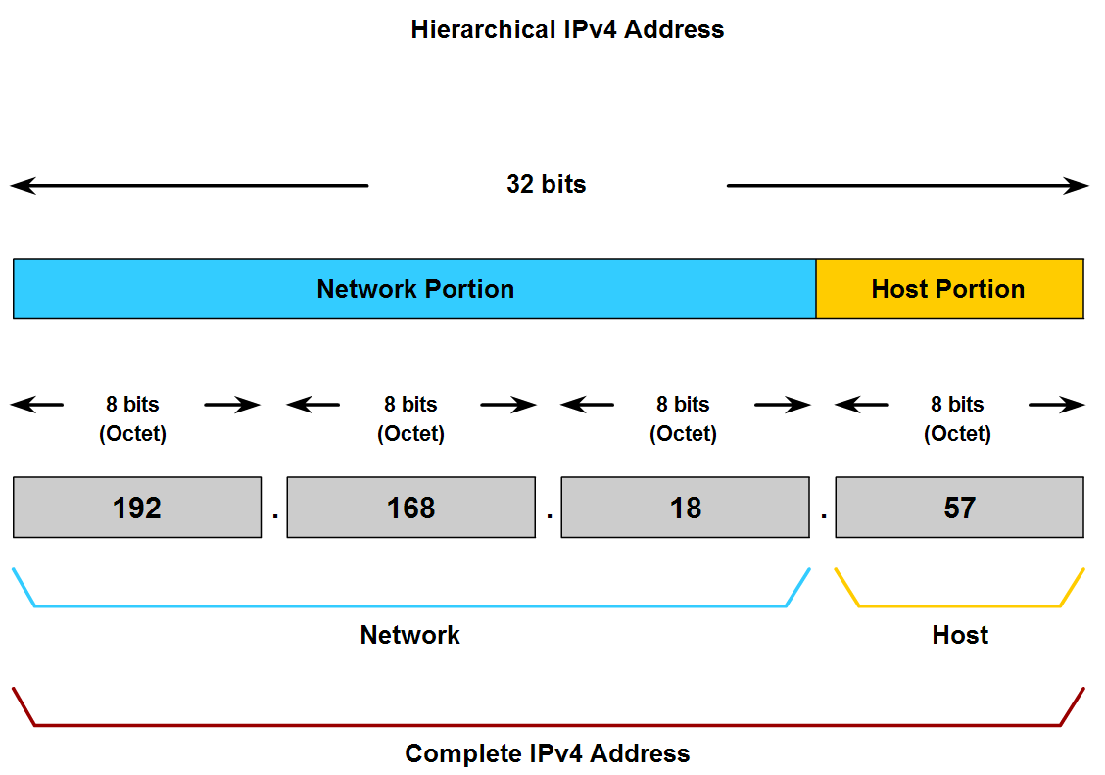
Grouping Devices into Networks and Hierarchical Addressing

Slide 20
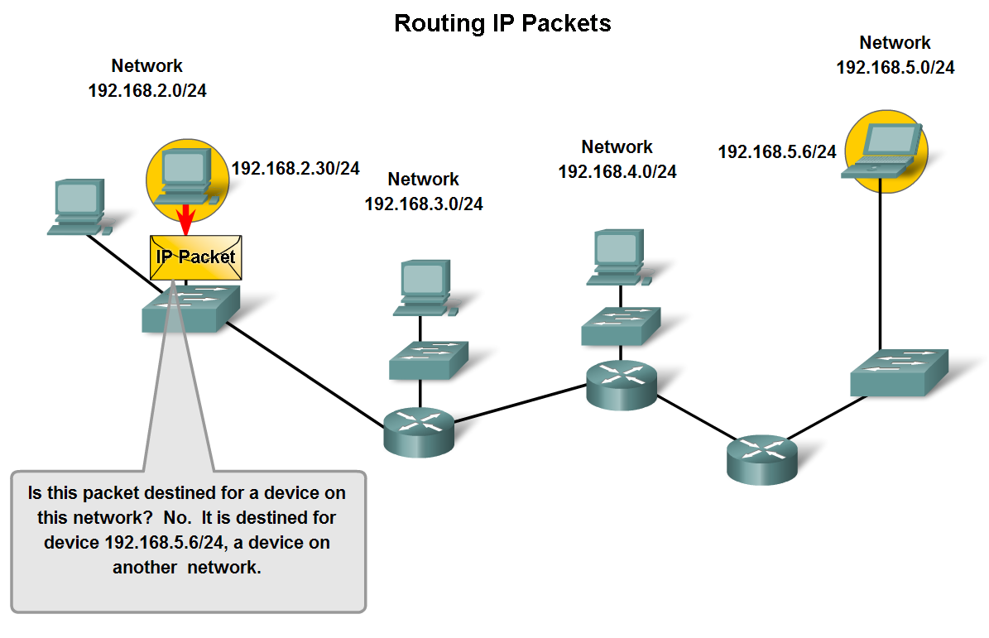
Fundamentals of Routes, Next Hop Addresses and Packet Forwarding
Trace the steps of an IP packet as it traverses unchanged via routers from sub network to sub-network

Slide 21
Data Link Role
For Network layer packets to be transported from source host to destination host, they must traverse different physical networks.
These physical networks can consist of different types of physical media such as copper wires, microwaves, optical fibers, and satellite links.
Network layer packets do not have a way to directly access these different media.
It is the role of the OSI Data Link layer to prepare Network layer packets for transmission and to control access to the physical media.

Slide 22
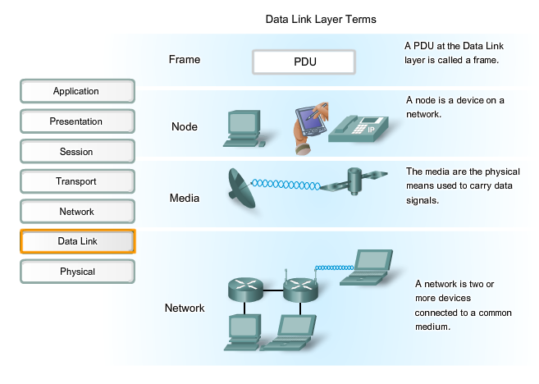
Data Link Terms

Slide 23
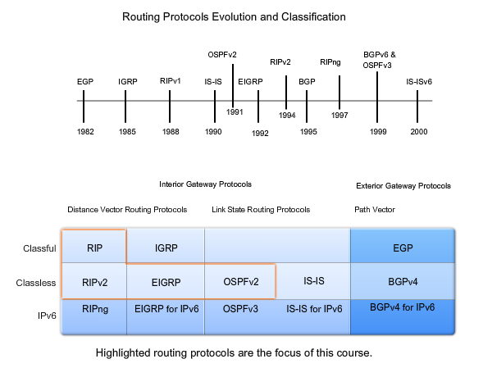
Protocol Evolution

Slide 24
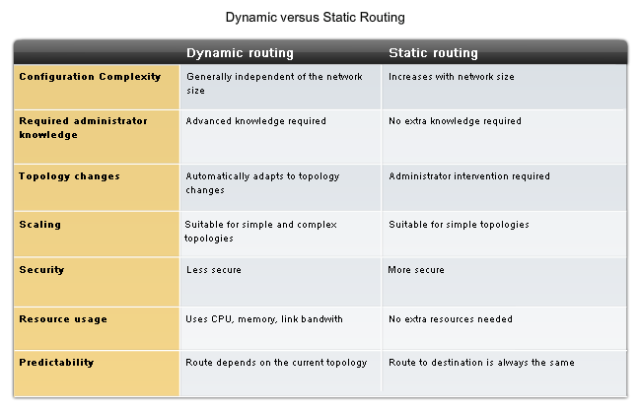
Dynamic vs. Static

Slide 25
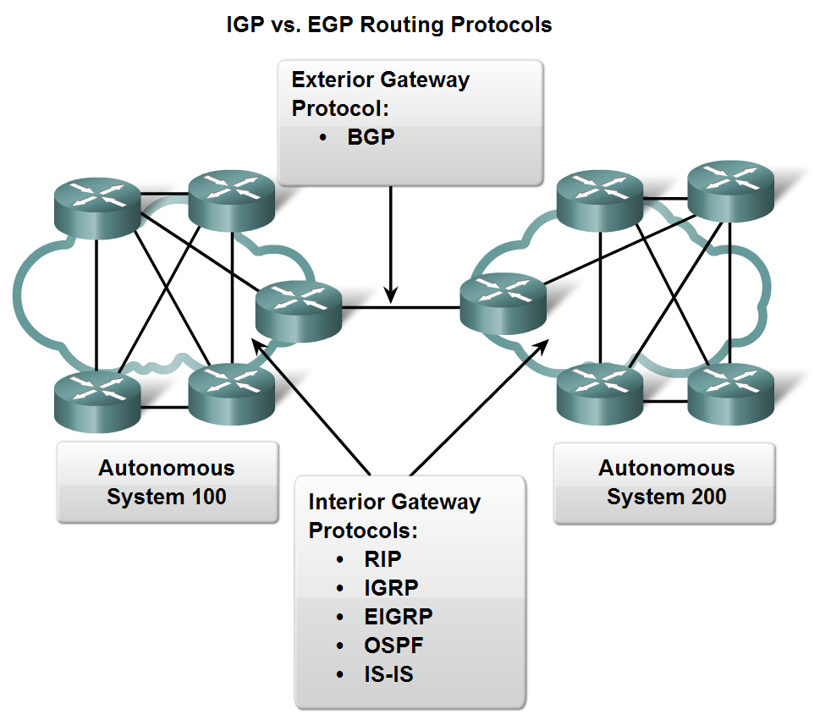
Classifying Routing Protocols
Types of routing protocols:
  -Interior Gateway Protocols (IGP)
  -Exterior Gateway Protocols (EGP)

Slide 26
Metrics
Metrics used in IP routing protocols include:
Hop count - A simple metric that counts the number of routers a packet must traverse
Bandwidth - Influences path selection by preferring the path with the highest bandwidth
Load - Considers the traffic utilization of a certain link
Delay - Considers the time a packet takes to traverse a path
Reliability - Assesses the probability of a link failure, calculated from the interface error count or previous link failures
Cost - A value determined either by the IOS or by the network administrator to indicate preference for a route. Cost can represent a metric, a combination of metrics or a policy.

Slide 27
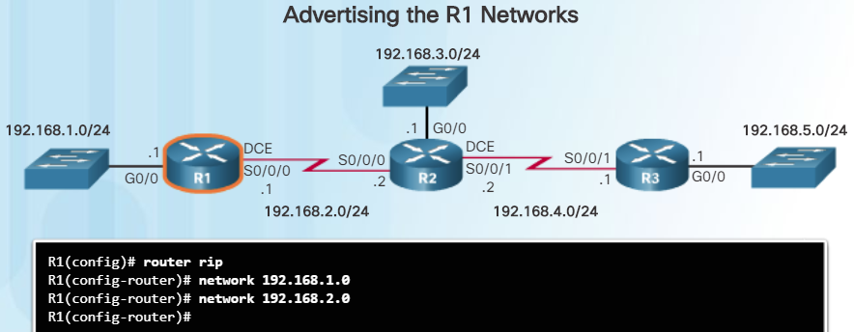
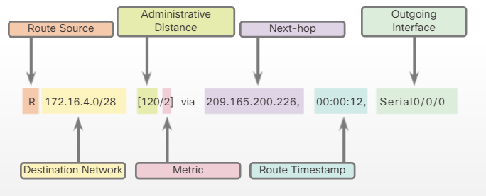
Configuring RIPv2

Slide 28
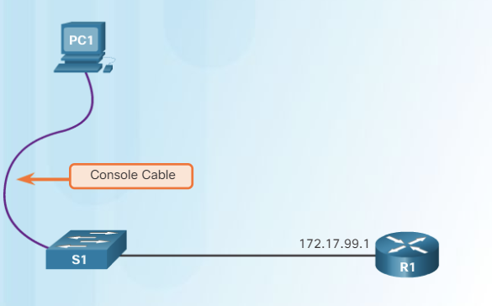
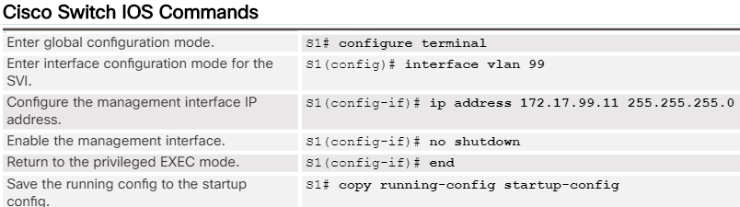
Configuring Switches

Slide 29
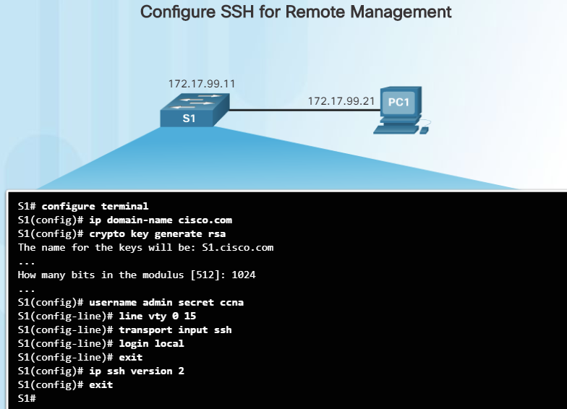
Configuring SSH

Slide 30
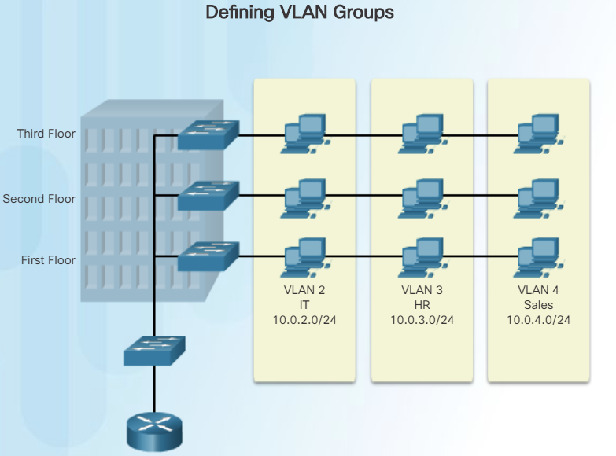
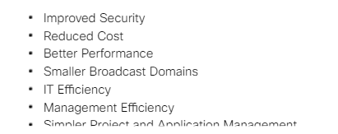
Configuring VLANs

Slide 31
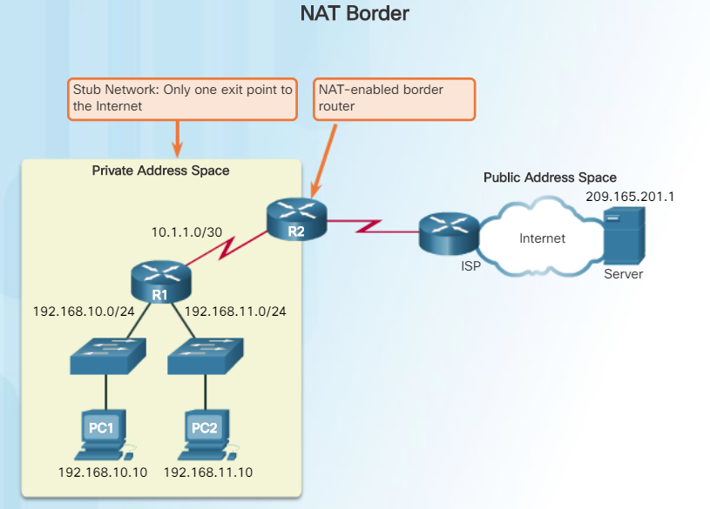
Infrastructure Services
ACLs – Access Control Lists
DHCP – Dynamic Host Configuration
NAT IPv4 – Network Address Translation

